Slide 1
Grand theft auto ece 532 H1S
Group 8: Yaron Milwid, Milos Nikolic, Neil Veira
TA: Charles Lo
Prof: Paul Chow
March 31, 2017

Slide 2
Outline
Overview of the project and initial goals
Problems we had
Third party IP used
IP we made
Design process
What we learned
Demo

Slide 3
Overview of the project and initial goals
Create a very limited autonomous toy car
Car navigates through an obstacle course, where the obstacles are a specific color
Data is sent from the car to the processor via WiFi and processed using an FPGA
Commands are sent to a PWM and then transmitted through a remote controller
We ended up achieving our initial goals

Slide 4
Problems we had
Vivado has many bugs
There are very few open-source JPEG decoders
The one we found was old, difficult to use, and buggy
There was very little documentation for the WiFi PMOD
Memory resources were very scarce

Slide 5

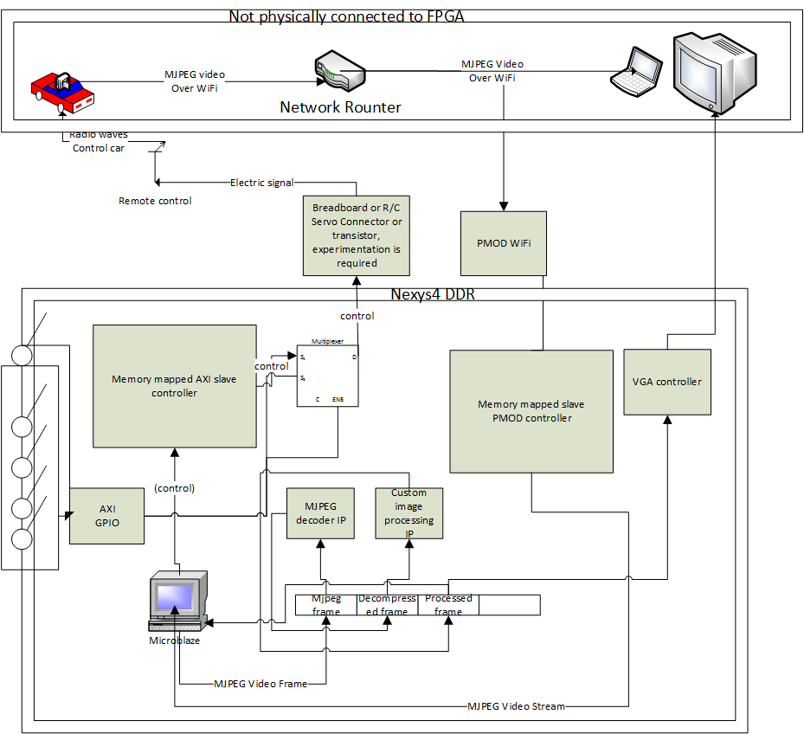
Original Flow Diagram

Slide 6
Revised Flow Diagram

Slide 7
Original Block Design

Slide 8
Revised Block Design

Slide 9
Third party IP used
WIFI PMOD from Digilent
This includes the TCP client code that we adapted
JPEG decoder from Opencores.org
FIFO Generator
DRAM, BRAM infrastructure
Microblaze infrastructure
AXI infrastructure
Clock generator
VGA driver from Rob Chapman (Altera University Program)

Slide 10
IP we made
Image processing (color thresholding and edge detection)
Control algorithm
PWM
VGA controller (uses third party VGA driver)

Slide 11
Design process
Develop broad concept
Constrain
Concurrently:
Create communication with outside world
Create logic
Work as separately as possible
Integrate

Slide 12
What we learned
Don’t trust the test-bench given with open source IP to be thorough
Don’t use different versions of software
Copy all files into projects
Check constraints manually since they are only validated by Vivado at generate bit-stream
When Vivado behaves unexpectedly restart
Concepts
Verilog
HTTP
Path-finding
VGA

Slide 13
Demo

